Slide 1
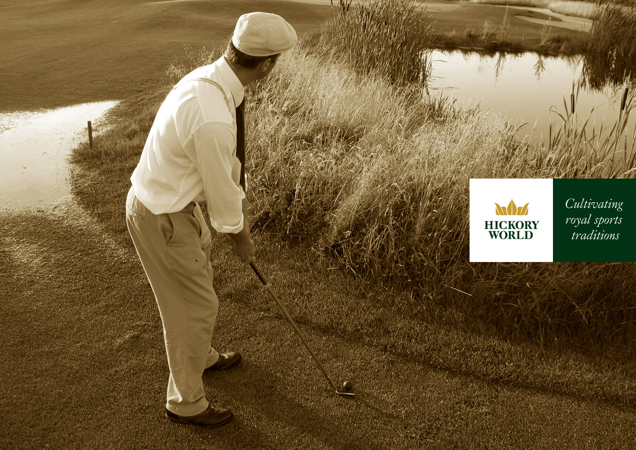

Slide 2

Cultivating Royal Sports Traditions !
Hickory Golf. Tennis. Polo & horse riding. Yachting. Country ski. Vintage cars.
All sports and games that have a link to the hickory era (or bygone times).
Our role is to cultivate traditions and cultural heritage on all aspects of historic sporting environments.
We understand there are other less tangible aspects of our heritage, aside from historical people, places and events.
These include active sporting activities together with art, culture and cuisine.
Our focus is on enhancing our own quality of life, especially in today’s current sedentary lifestyle.
In contributing to the familiar, aesthetic quality of our surroundings, the outdoor historic sports environment
enhances our sense of well-being. It is all around us and easily accessible, and provides a setting for
a great variety of activities.
The historic environment is fundamental to our sense of place - it helps link us to our roots and underpins our sense of
cultural identity. It is of value for what it tells us about past society, culture and human interaction with the environment,
and it helps give us a long-term view of social and environmental change.
To cultivate the traditions and spirit of the royal and ancient game of golf.
To organise social and competitive events so as to experience and enjoy golf and other sports as they were played in the past,
and to appreciate the challenges posed by period equipment.
To share information related to the history of sports, mainly on the European continent
To maintain and encourage relationships between any organisations related to sports heritage.

Slide 3

HICKORY WORLD CHAMPIONSHIP PROGRAM
21-23th October 2011
21st October 2011 - Collectors Day
12.00 – Hickory Exhibition opening
18.00 – Press conference
Hickory Golf royal and ancient traditions - 100 years of Golf
on Polish teritory
19.00 – Hickory Cocktail
22nd October 2011 – Hickory 20ties LifeStyle Day
10.00 – Practise round at FWG&CC
15.00 – Warsaw 20ties sight seeing
19.30 – Hickory Auction
20.00 – Hickory 20ties Gala dinner
-23rd October 2011-
Polish Hickory Championship Day
10.00 – Polish Hickory Championship Shot Gun - FWG&CC
17.00 – Polish Olimpic Centre: Prize ceremony
18.00 – Cocktail

Slide 4
